Slide 1


Software infrastructure supporting Bioinformatics/Biomathematics Training provision & Reproducible Research
Mark Fernandes

Slide 2






BioInformatics / BioMathematics Training information provision & Integration (MAF V1.4 August 2015)
Trainers
Intranet Calendar DB
TGAC – BBSRC BI/BM Training Hub
Links?
XML feed
Other BBSRC BI training sites
Training materials Wiki (moodle.ifr.ac.uk/wikitrain/) (Built but not live yet)
NBI BI/BM Training Blog
(scicomp-training.ifr.ac.uk, scicomp-training.nbi.ac.uk)
Web-links to E-courses
Moodle E-learning Course Server (moodle.ifr.ac.uk/moodle/)
Users
Linux training server VM (Using Docker engine & software containers)

Slide 3

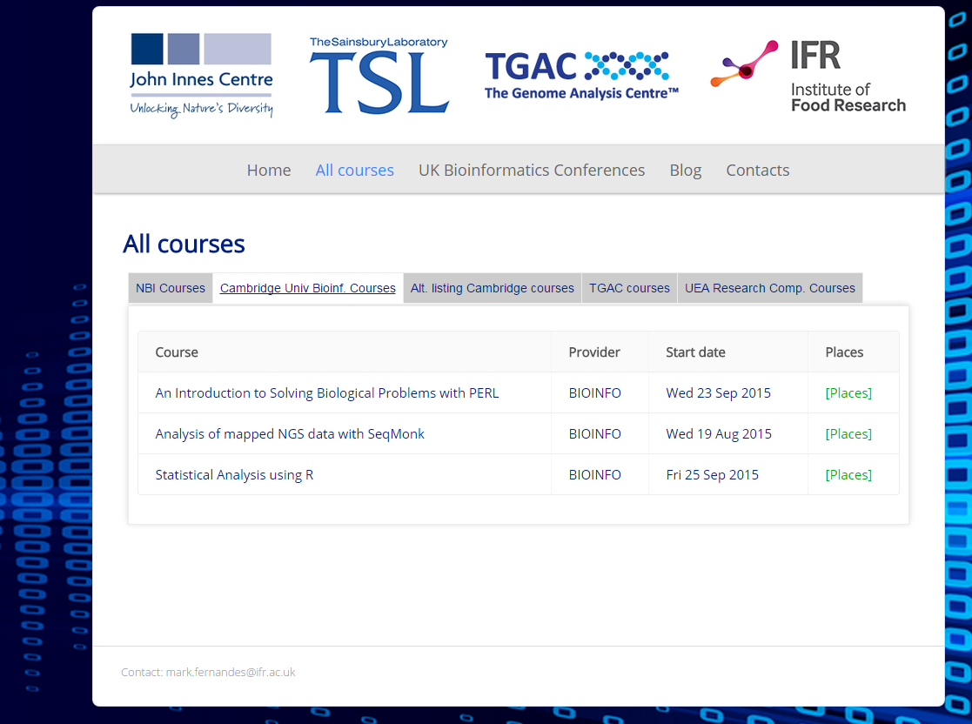

Blog - screenshot of courses aggregator

Slide 4
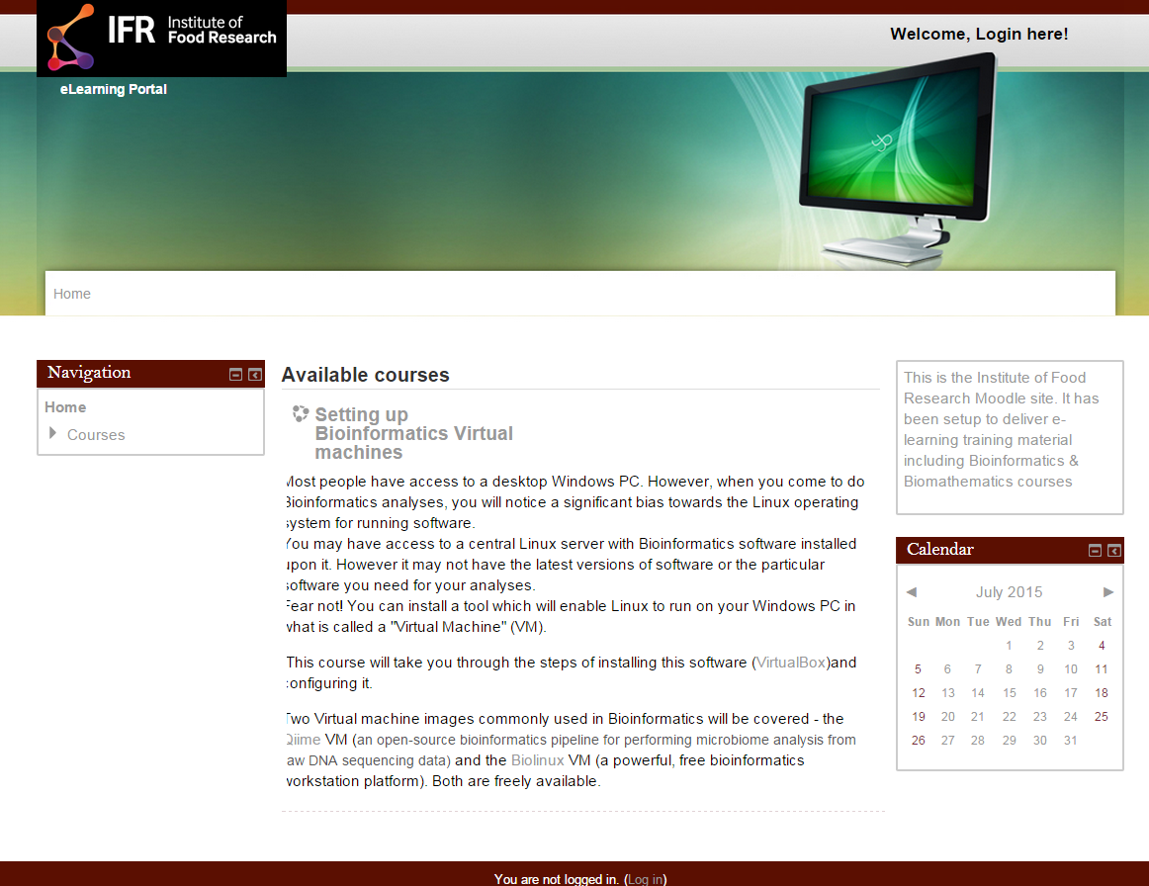

IFR Moodle – work in progress…
Training topics
16S / QIIME
Linux

Slide 5
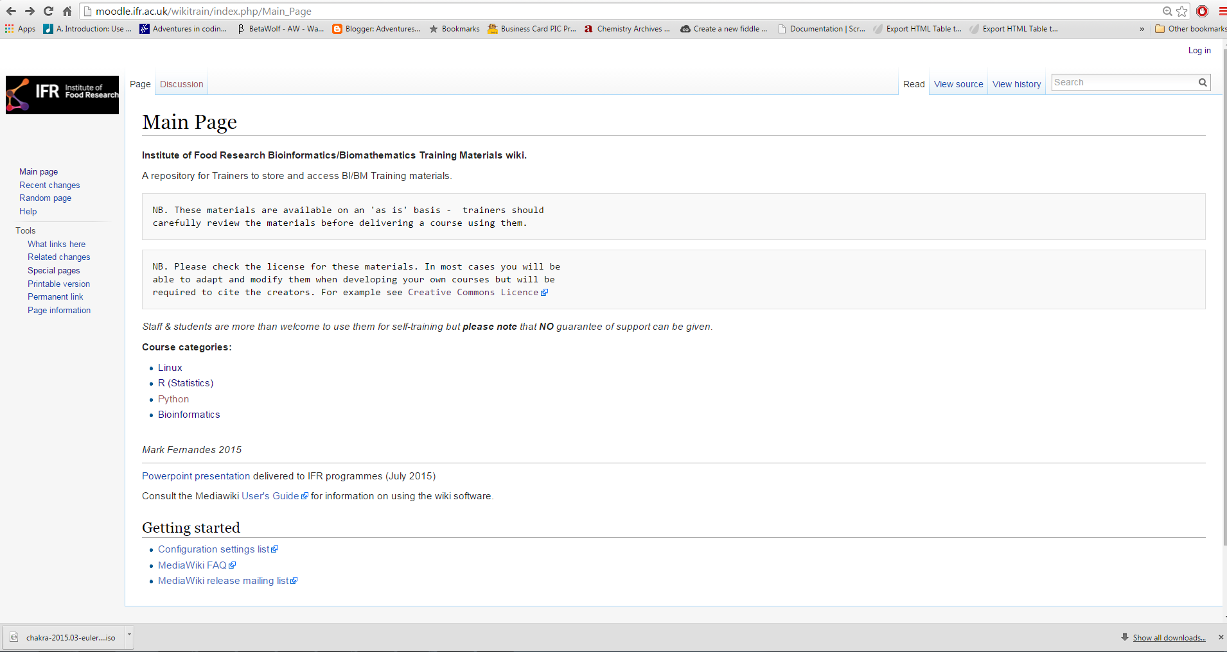

Slide 6
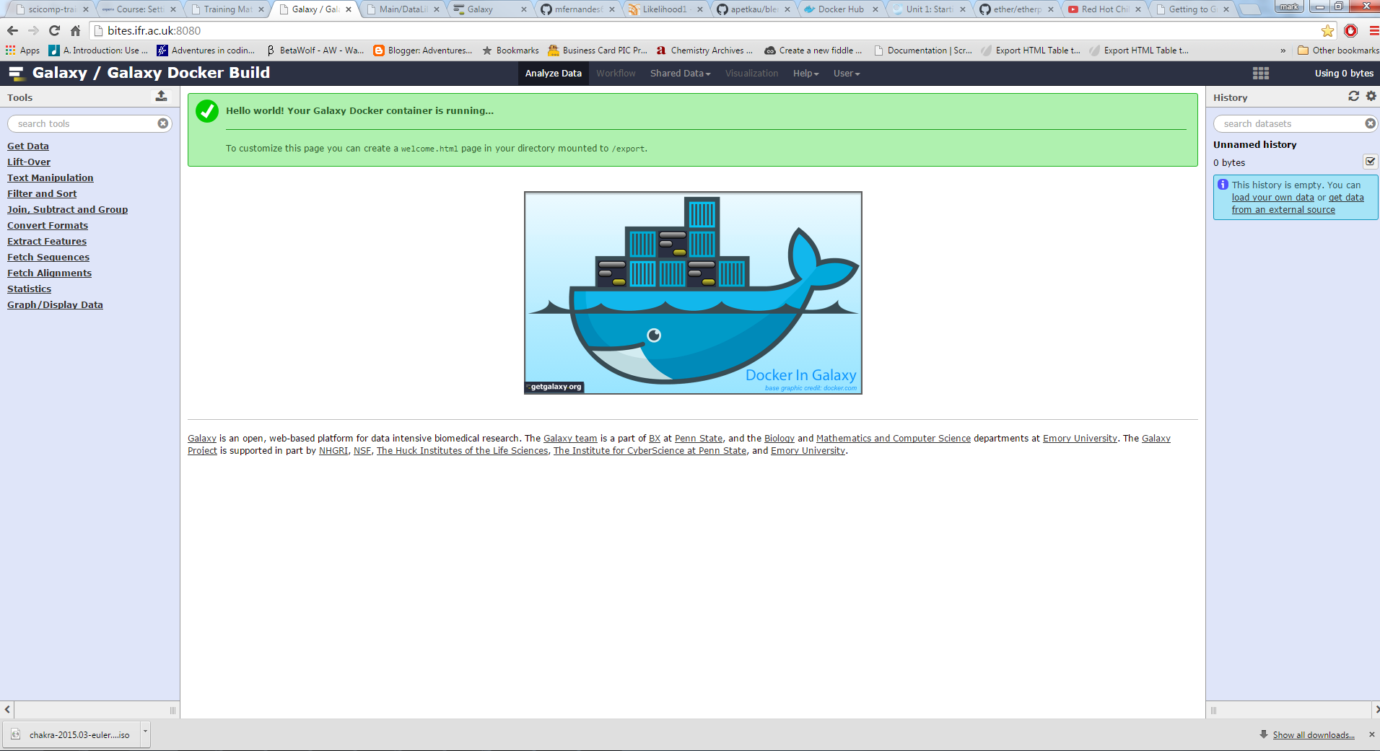
BITES – Bioinformatics Training Environments Server
Linux VM running Docker engine with multiple containers e.g. Galaxy servers

Slide 7
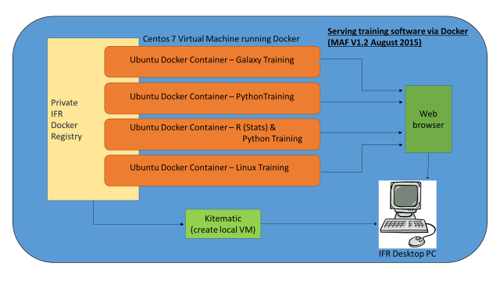
(Itself a Docker Container)

Slide 8

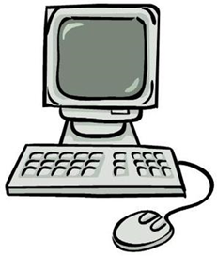
Proposed outward facing Docker Registry with
authenticated upload and public download
IFR External Docker
Registry
(LDAP/AD Auth.?)
Published CLI BI pipeline container
Linux server running
Docker engine
Training environment container e.g. RNA-seq
Training environment container e.g. Ipython Notebook
Training environment container e.g. R-studio web
Desktop PC
running Kitematic
NB One IFR group has already Dockerised their pipelines with an aim to publish via this route

Slide 9
Software tools that may have been harmed in the making of this project:
Docker (https://www.docker.com/)
Docker toolkit nee. Kitematic (https://www.docker.com/docker-toolbox)
Galaxy (https://galaxyproject.org/)
R-studio(web) (https://www.rstudio.com/products/RStudio/#Server)
Ipython Notebook (http://ipython.org/notebook.html)
Wordpress (https://wordpress.com/)
Mediawiki (https://www.mediawiki.org/wiki/MediaWiki)
Camtasia (Commercial) (https://www.techsmith.com/camtasia.html)
Moodle (https://moodle.org/)
Sony Vegas Movie Studio (Commercial) (http://www.sonycreativesoftware.com/moviestudio)
Etherpad (https://github.com/ether/etherpad-lite)
(Future usage)
Open Broadcaster software (https://obsproject.com/)

Slide 10

Thank you –
Any Questions?

